Slide 1
Introduction to Research
Quantitative Research Characteristics
- Describing the problem through a description of trends or an explanation of the relationship between variables.
- Providing a major role for the literature through suggesting the research question.
- Creating purpose statements, questions and hypothesis that are specific.
- Collecting numerical data.
- Analysing trends, comparing groups or relating variables using statistical methods, writing the research report.
cont…

Slide 2

Introduction to Research
Quantitative Research
-In quantitative research you identify the research problem.
- In some quantitative research you may need to explain how one variable affect another.
- In quantitative research report you will see a substantial literature review at the beginning of the report.
- Literature also creates a need for the study – as seen in the purpose statement, research question or the hypothesis

Slide 3
Introduction to Research
Quantitative Research
- In quantitative research you ask specific narrow questions.
- In quantitative research you use an instrument to measure the variables.
- In quantitative research you analyse data using mathematical procedures called statistics.

Slide 4
Introduction to Research
Quantitative Designs
- Experimental – where the research is seeking to see whether an intervention has an affect on an individual.
- Correlational – the focus in on examining the relation between two or more entities.
- Survey – where the researcher looks to describe trends.

Slide 5
Introduction to Research
Qualitative Research Characteristics
- Exploring a problem and developing a detailed understanding of the central phenomenon.
- The literature review plays a minor role, but justifies the problem.
- Stating the purpose and research question in a broad way.
- Collecting data based on words – participants views
- Analysing data for description and themes

Slide 6
Introduction to Research
Qualitative Research
- Qualitative research is best suited to address a research question where you don’t know the variables and need to explore.
- A central phenomenon is the key concept, idea or process to be studied.
- In qualitative research the literature review plays a less substantial role in the beginning of the study.

Slide 7
Introduction to Research
Qualitative Research
- In qualitative research the purpose statement and the research questions are stated so that you can best learn from the participants.
- In qualitative research, you collect data to learn from the participants in the study develop forms, called protocols for recording data.
- In qualitative research typically you gather a text database, so the data analysis of text consists of dividing into groups of sentences, called text segments and determine the meaning of each group sentences.

Slide 8

Introduction to Research
Problems with research.
1. Results sometimes vague or contradictory.
2. People looking for hard results are disappointed.
3. Research accumulates slowly.
4. The issue of questionable data.

Slide 9

Introduction to Research
Qualitative Research Methods
Is the other research method, and is used where you wish to study some phenomena but don’t have a hypothesis.

Slide 10

Introduction to Research
Qualitative Methods are best suited to address a research problem in which you do not know the variables and need to explore.

Slide 11
Introduction to Research
Characteristics of Qualitative Methods
- Exploring a problem and developing a detailed understanding of a central phenomenon.
- Having the literature review play a minor role but justify the problem.
- Collecting data based on words from a small number of individuals so that the participants views can be obtained.
Cont…

Slide 12
Introduction to Research
Characteristics of Qualitative Methods
- Analysing the data for description and themes using text analysis and interpreting the larger meaning of the findings.
- Writing the report using flexible, emerging structures and evaluative criteria and including the researchers subjective reflexivity and bias.

Slide 13
Introduction to Research
Qualitative Research
A central phenomenon is the key concept, idea or process studied in qualitative research.
In qualitative research the purpose statement and research questions are stated so that you can best learn for the participants.
Cont…

Slide 14
Introduction to Research
Qualitative Research
You collect data to learn from the participants in the study and develop forms called protocols for recording data. An example could include an interview protocol. They can be seen as a set of rules or guidelines
It typically gather text database, so the data analysis of the text consists of dividing it into groups of sentences called text segments and determining the meaning of each group of sentences.

Slide 15
Introduction to Research
Similarities and differences between quantitative and qualitative research.
- Both forms of research follow the six steps in the process.
- Both methods employ similar data collections process.
- Once data is collected they used distinctly different analysis methods.
However, you should see the quantitative and qualitative as on a continuum rather than a dichotomy.

Slide 16

Introduction to Research
Qualitative Vs Quantitative

Slide 17
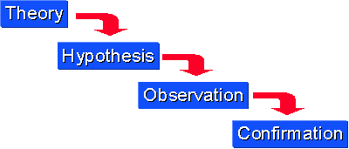
Introduction to Research
Quantitative Research – Deductive Reasoning
We might begin with thinking up a theory about our
topic of interest. We then narrow that down into more
specific hypotheses that we can test. We narrow down
even further when we collect observations to address
the hypotheses. This ultimately leads us to be able to
test the hypotheses with specific data.

Slide 18
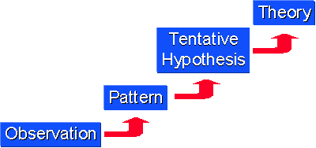
Introduction to Research
Qualitative Research – Inductive Reasoning
Inductive reasoning, we begin with specific observations
and measures, begin to detect patterns and regularities,
formulate some tentative hypotheses that we can
explore, and finally end up developing some
general conclusions or theories.

Slide 19
Introduction to Research
Design Science
- Relatively new methodology however suits IT research and is gaining ground as the major research methodology in IT especially in software development research.

